Slide 1
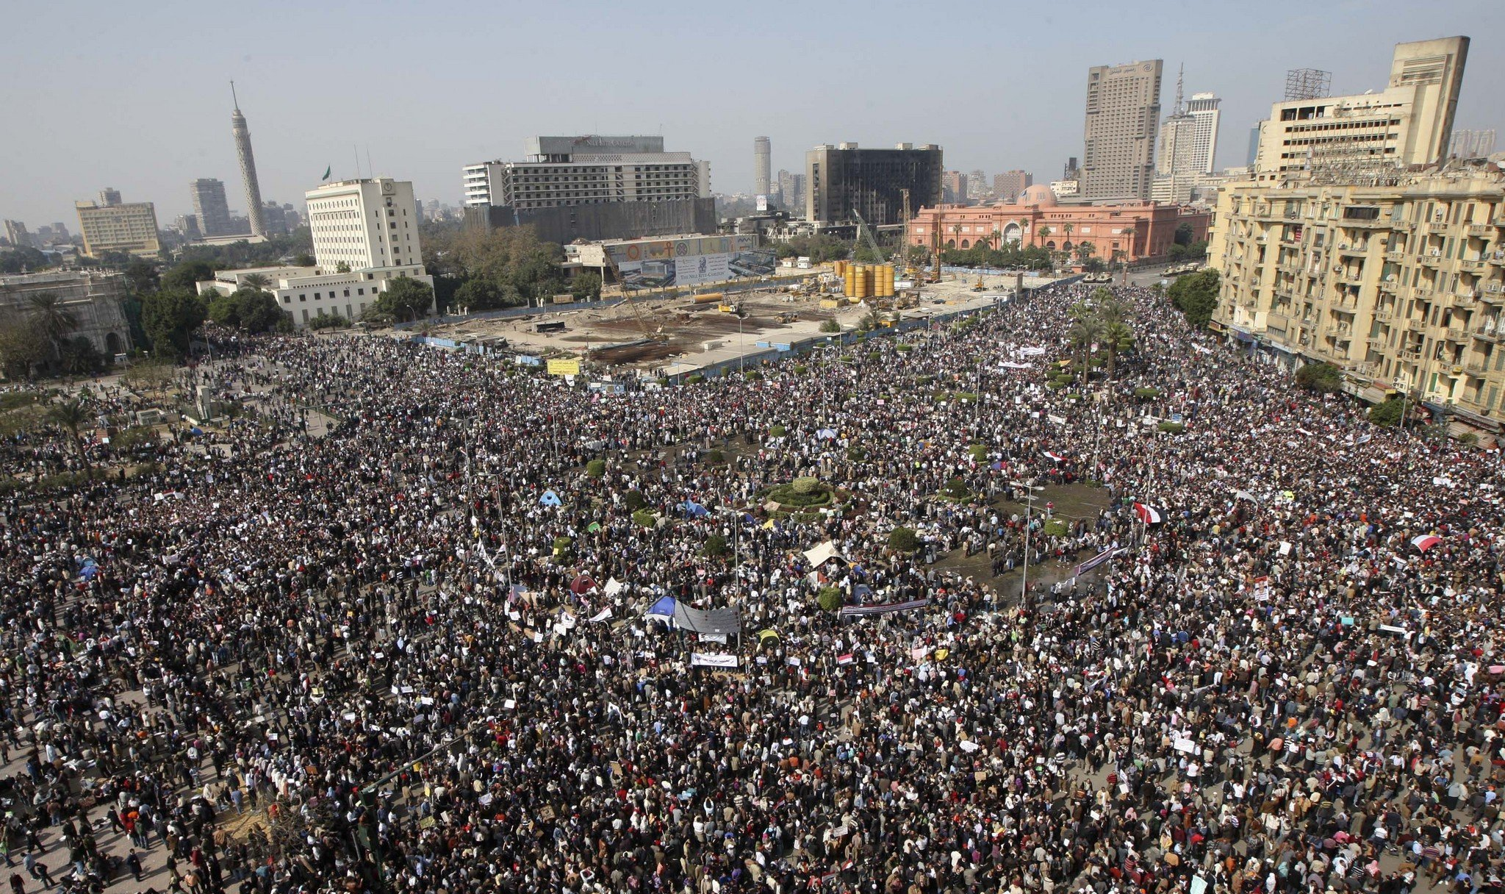
Human Labor in LCA
Carter Reeb
LCA Research Group Presentation
April 2nd, 2012

Slide 2
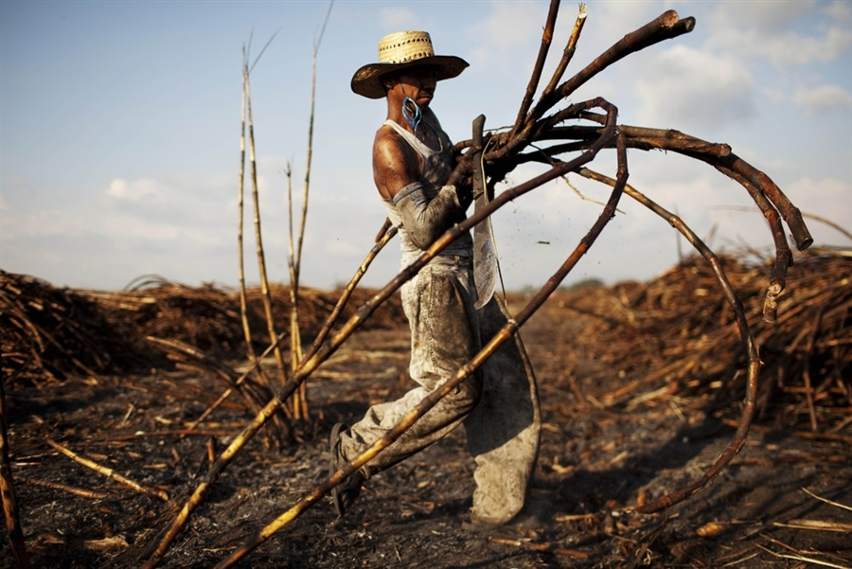
Human Labor?
Human Labor (HL) is non-work activities which make human labor possible. HL, as integrated into an environmental LCA defines these activities and quantifies the impacts of these activities.
Ex: sleeping, eating, hobbies, travel, etc.

Slide 3
Methods
Develop a system boundary for HL
Define scope
Person emissions based upon Household Expenditure (HE) values for a specific region
FTE * Impacts/Person/Year (geographically specific)
Conduct HL LCIA
Allocate impacts to product/service
Work Hours/8,766 Hours per year
22% according to Rugani et al. (2012)
Incorporate into larger LCA

Slide 4
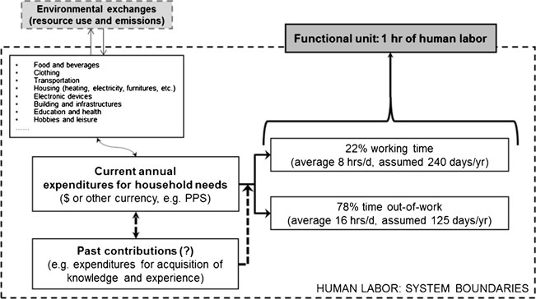
HL System Boundary
Rugani et al., 2008

Slide 5
HL Calculation Methods
Total Food Consumed (TFC) – converts hours of labor into an energy equivalent value
Adult Equivalency for a single adult (weighted as 1.0). 0.5 equivalency for each additional adult and 0.3 for each child.
Replacement factor for machinery

Slide 6
Results
“Man-hours” per functional unit, per unit time
Machinery Replacement man-hours
Energy Equivalency Values range between 0.62 and 12.1 MJ/person/h
ReCiPE, TRACI, etc.

Slide 7
Human Labor LCIA
Man hours calculated per activity for the functional unit
Man hours assigned a HE designation
Man hours X HE values for each activity and summed for each life cycle stage
HL summed across life cycle and also summed with other environmental burdens.

Slide 8
Standard HE Values

Slide 9
Allocation
Total annual hours = 8766 hours
Estimated annual man-hours = x
240 work days at ~8 hours per = 1,920 hours (22% of the year)
Allocation = (x hours/8766 hours) *100
Silalertruksa and Gheewala (2009) suggest 442 man hours per hectare.
From this calculate workers needed and allocated HL burdens

Slide 10
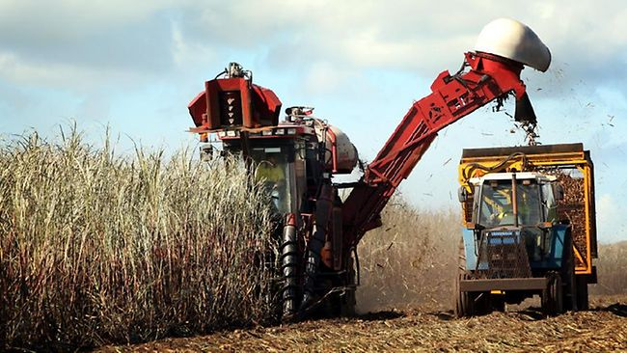
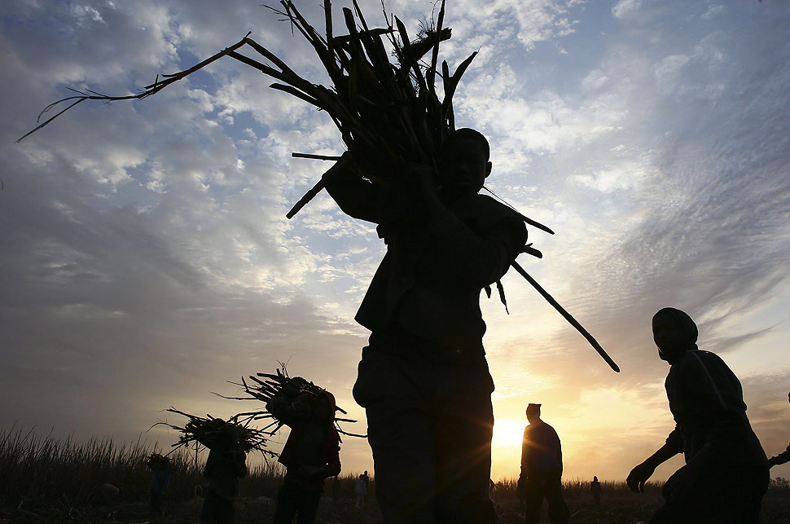
Incorporation of HL into Main LCA
HL becomes just another flow in product systems
LCI for HL incorporated into main LCI dataset

Slide 11
Case Study – Thai Sugarcane
Silalertruksa and Gheewala, 2009
LCA of Thai Sugarcane to Bioethanol, HL included
HL assumed for cultivation and harvest
Takes into account the production of fertilizers, herbicides, fuel, grid-mix electricity and human labor in the system boundary
TFC method used – 2.3 MJ/hour (HL energy equivalency).
An average human labor of 466 man-hours per hectare of sugarcane is required for all farming activities including land preparation, planting, crop maintenance and harvesting
Impact due to HL:

Slide 12
Problems?
“Classes” of HE directly relatable to “impact”
Lower class worker has lesser “impact” due to his/her existence and participation in the life cycle.
Solely used for attributional to date
Often increasing scope of LCA to include HL makes the whole LCA too in-depth.

Slide 13
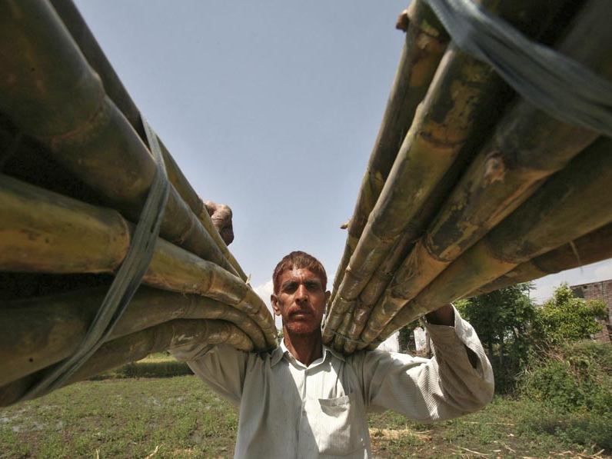
Questions?

Slide 14
Sources
Spirinckx and Ceuterick 1996;Milà et al. 1998; Nebel et al. 2006 (HL not included)
Silalertruksa and Gheewala, 2009
Rugani et al., 2012
Nanaki and Koroneos, 2012
Muñoz et al. 2008, 2010
Nguyen et al. 2007
(Nguyen and Gheewala 2008a,b; Silalertruksa and Gheewala 2009

